Slide 1
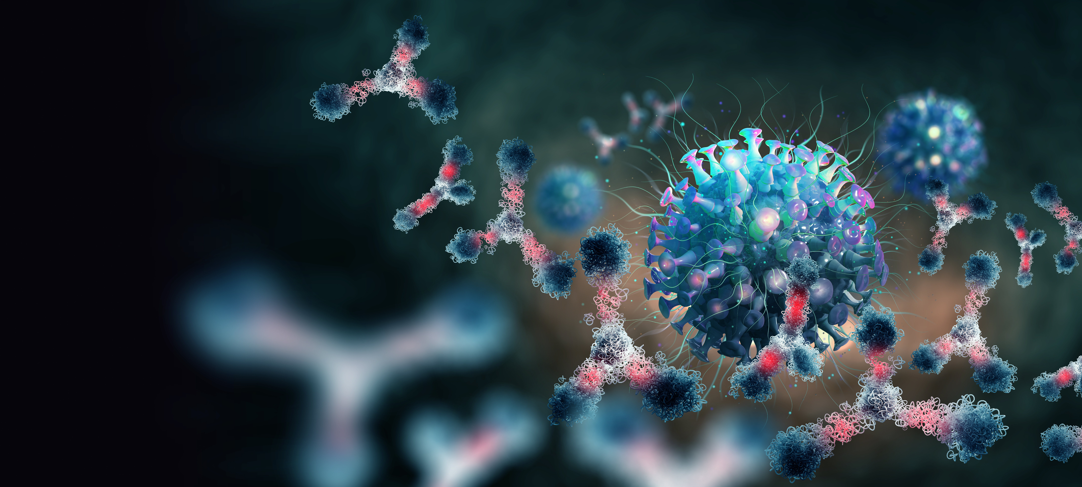
Facilitate Your Antibody Discovery
2022
One-Stop Solution for Antibody Generation at GenScript

Slide 2

About GenScript

Slide 3
History & Milestones of GenScript Group
2021
Opened a new R&D and production facility in Singapore
Opened Shanghai Site for cell engineering and virus production
Opened a new High-throughput US Facility
2018
2015
Legend Biotech BCMA program received IND clearance in US and China
GenScript Biotech listed in HKEX (Stock code:1548)
2013
Launched Bestzyme (subsidiary company specialized in industrial synthetic biology products)
2009
Received $15 million dollar investment from KPCB / TBIG Healthcare
2002
2019
Founded in New Jersey, US
Launched the first custom gene synthesis platform
2017
Subsidiary company Legend Biotech New Biologics GMP CDMO R&D center
Established European & Asia-Pacific Division to facilitate global strategy
CAR-T products received Orphan Drug Designation (FDA) and were recognized as breakthrough therapy; clinical data showed a 100% remission rate
Launched GenScript ProBio (specialized in biologics CDMO)
Legend Biotech and Janssen entered into collaboration on the BCMA program
Acquired 100% of the issued shares of CustomArray
BCMA program received Orphan Drug Designation (FDA) & PRIME Designation (EMA)
2020
Legend was listed on NASDAQ on June 5 and becomes China's first CAR-T stock
GenScript and Duke-NUS Medical School, launched first-in-the-world cPassTM SARS-CoV-2 Neutralization Antibody Detection Kit
Finished the construction of the world's largest customized peptide service platform
2014
Launched Legend Biotech (subsidiary company specialized in
cell therapy)
CRO Leadership Award
2011
2004
Opened a new R&D and production facility in Nanjing
Established subsidiary in Japan
Established custom protein and antibody services, R&D and production site in Nanjing, China

Slide 4

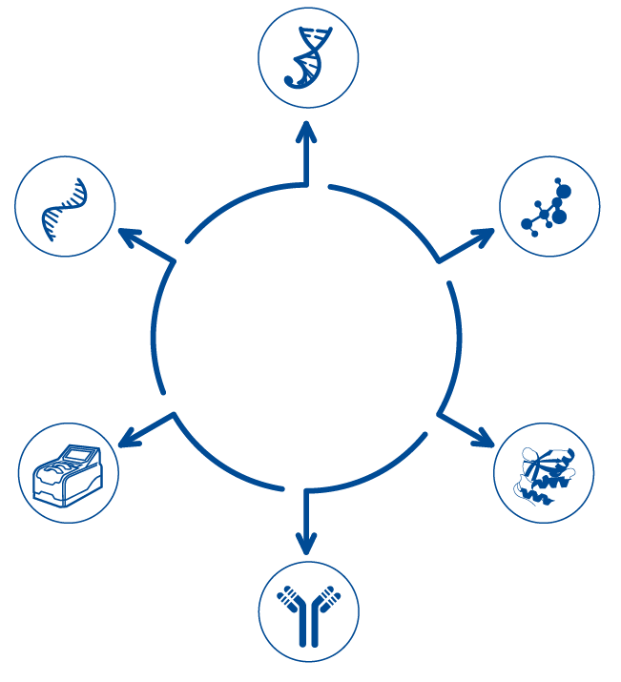



Business Overview
Life Science CRO
Gene Synthesis
Global Leader in research services Market
Oligonucleotide
Synthesis
Peptide
Synthesis
Industrial Synthetic
Biology Products
Fast growing industrial enzyme producer
Life
Science
CRO
Cell Therapy
Global leader in CAR-T technology
Products
Protein Sciences
Biologics CDMO
Reagent Antibody
Development
Emerging Leader of CDMO Service provider in China

Slide 5
Complete IP Protection
Usage
Account management
Role authority management
Anti-sneak shot & screenshot
Generation
Transmission
Mail basic encryption
Mail outgoing audit
High-secret information transmission
Secret level identification
Secret level classification
Client Info.
Storage
Destruction
Control of removable media
Management of physical assets
Lock and keep the information assets
Management of the printing of confidential information
Destruction management

Slide 6


Overview of Our Facilities for Antibody Discovery
ISO certification for design, manufacture and distribution of antibodies for in-vitro diagnostic medical devices.
AAALAC International and OLAW accredited animal facility.
A 6,000 sq.m facility, hosting more than 3,000 rabbits and 30,000 rodents
Providing a broad range of antibody services from individual cases or bulk orders
On-site Veterinary Staff to monitor and ensure the health of our animals

Slide 7
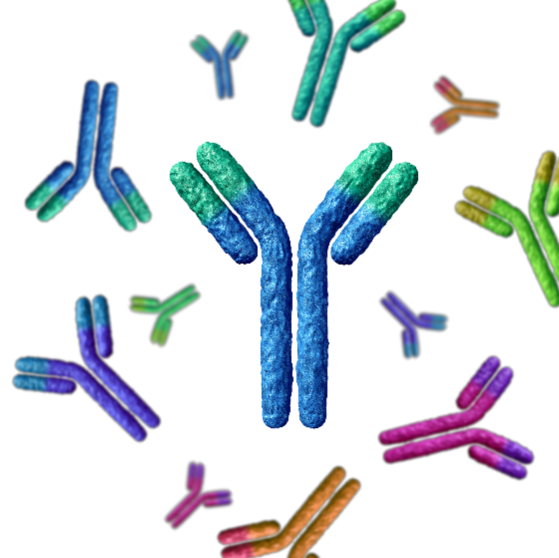
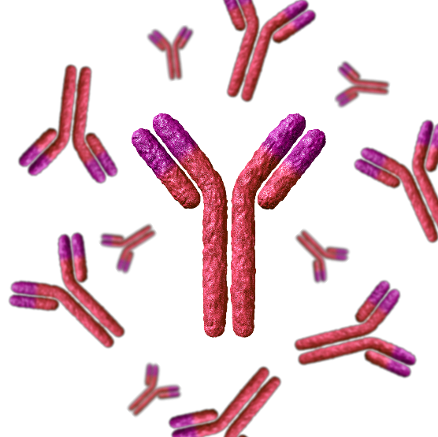


Polyclonal Antibody
Monoclonal Antibody (Rodent and Rabbit)
Reagent Antibody Services
Antibody Sequencing & Production
Custom ELISA Kit Development

Slide 8
Polyclonal Antibody

Slide 9
PloyExpressTM Guaranteed Polyclonal Antibody Packages
Feature | Details | SC1180 | SC1676
Immunization | 2 Rabbits | 1 peptide | 1 protein
Deliverables | Antigen sample | 2 mg peptide antigen | 200 μg protein antigen
 | pAbs | 1 pAb | 2 pAbs
Guarantee | Antibody Yield | ≥ 2 mg (ELISA titer 1:256,000) | 1.5-6mg / rabbit (ELISA titer 1:256,000)
 | Timeline | 45 days | 10-11 wks
Cost effective and Comprehensive: Starting from antigen synthesis and purification!
Fast Timeline: As little as 45 days.
Guarantee: Affinity-purified polyclonal antibody quantities and ELISA titer of 1:256,000.
Certified facility: AAALAC International accreditation and OLAW certification.

Slide 10
Custom Polyclonal Antibody Packages
Features | Rabbit Package | Mouse Package | Rat Package
Antigen (synthesized by GenScript or provided by customer) | Peptide Protein | Peptide Protein | Peptide Protein
Immunization | 2 Rabbits | 5 Mice | 3 Rats
Purification | Affinity Purified | Affinity Purified | Affinity Purified
Deliverables | purified pAbs (ELISA titer >1:256,000) from 40 ml serum per rabbit | purified pAbs (ELISA titer >1:256,000) from 0.5 ml serum per mouse | purified pAbs (ELISA titer >1:256,000) from 1.5-2 ml serum per rat
Timeline | 13 weeks | 13 weeks | 13 weeks

Slide 11
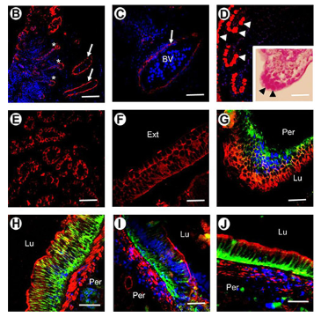
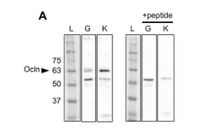
Case study
Harness the Power of Custom Polyclonal Antibodies to Uncover Novel Proteins
Custom polyclonal antibodies allow you to specify, validate, and visualize specific protein targets.

Slide 12
Monoclonal Antibody

Slide 13
Different Monoclonal Ab Packages for Different Projects
ANTIBODY PROJECT COMPLEXITY
MINIMAL
Simple antigen
Several mAb clones needed
No counter screening required
MODERATE
Specific immunization requirements
Many mAb clones needed
Counter screening required
MAXIMAL
Challenging antigen
Specific immunization requirements
Many mAb clones needed
Additional screening required
Accelerated (by MonoBoost)
and Classic Mouse mAb
Custom Rodent mAb,
MonoRab™ Rabbit mAb
Custom Rodent mAb,
MonoRab™ Rabbit mAb
Single B Cell Sorting Rabbit mAb
RECOMMENDED GENSCRIPT SERVICES

Slide 14
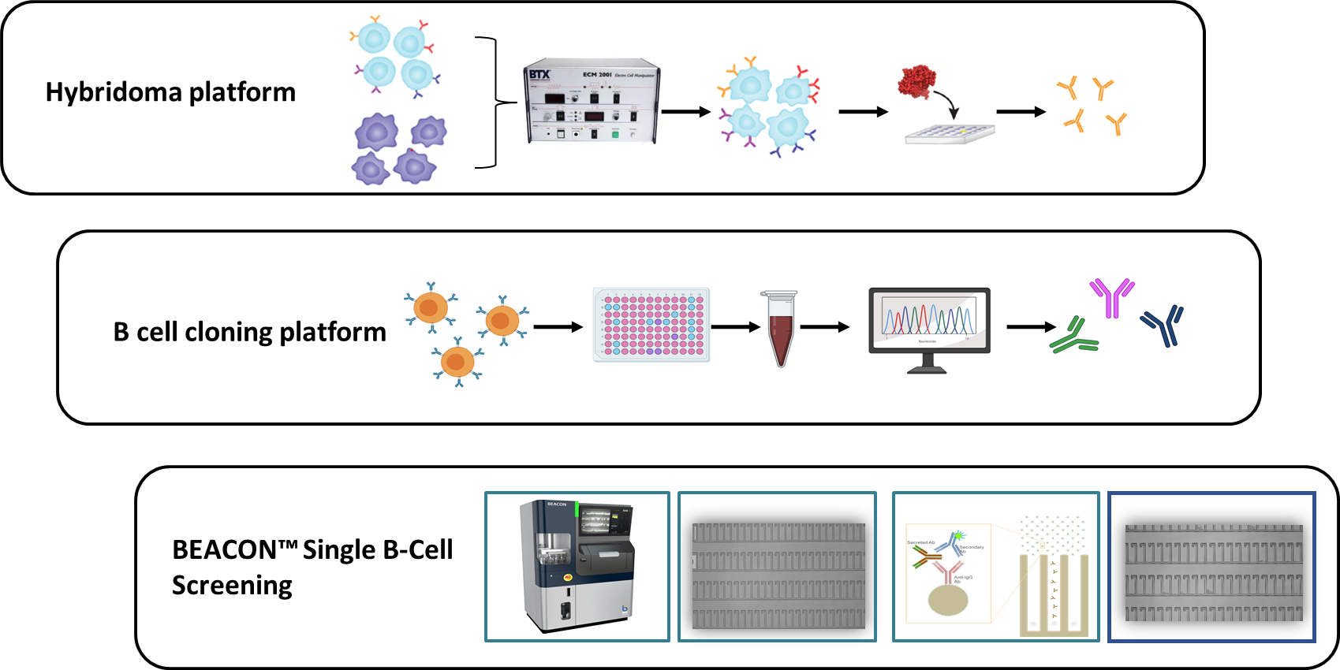
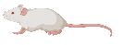

Different Screening Platforms for Best Antibody Diversity and Epitope Coverage
14

Slide 15
Comparison of Different Screening Platforms
Features | Hybridoma | B Cell Cloning | Beacon (Single B Cell Sorting)
Antibody Source | Splenocytes | Cultured B cells | Cultured B cells
Technology | Conventional | Newer | Latest
Time Screening | 3 months | 1-2 months | 1 day
Naïve L/H pairing | Y | Y/N | Y
Typical Affinity | 10⁸⁻⁹ | 10¹⁰⁻¹¹ | > 10¹⁰
Price | $ | $$ | $$$
Antibody Diversity | Medium | High | Higher
Species | Rodent | Rabbit | Rabbit
Supernatant delivery for in house testing | Y | Y | N

Slide 16
Rodent Monoclonal Antibody

Slide 17
Hybridoma Platform for Rodent mAb Generation
Immunization
Fusion & screening
Subcloning, screening, expansion
Antigen optimization & production
Capitalizing on the animal’s natural immune system to generate high-quality antibody leads

Slide 18

Guaranteed Mouse Monoclonal Antibody Packages
Feature | Accelerated By MonoBoostTM (SC2129) |  | Classic (SC2128)
Starting Material | Antigen generated by GenScript or customer
Immunization | 3 mice |  | 5 mice
Customer Screening | 30 ELISA positive supernatants |  | 20 ELISA positive supernatants
Deliverables | 1 WB positive clone Up to 5 hybridoma cell lines (2 vials/clone) 2 mg purified mAb from 1 clone 0.2 mg purified antigen (if GenScript provides) |  | 200 μg protein antigen
Timeline | 14 wks | 18wks
Guarantee | At least 1 WB positive clone and ELISA ≥ 1:64,000 |  | 1.5-6mg / rabbit (ELISA titer 1:256,000)
Application Guaranteed: Delivered mAb clones are Western blot positive and possess an ELISA titer ≥ 1:64,000.
Worry-free: Our safety net policy means your mAb investment is protected.
Certified facility: AAALAC International accreditation and OLAW certification demonstrate our commitment to responsible animal care and use.

Slide 19
Custom Rodent Monoclonal Antibody Package
Phase | Service Details | Deliverables | Timeline
Phase 0 Antigen Preparation | Antigen provided by GenScript or customer | Remaining antigen | 4-5 wks
Phase I Immunization | MonoBoost™ protocol or conventional protocol ImmunoPlus Technology Animals: BALB/c mice, C57BL6 mice, or rats | Test bleed report (optional: total serum protein delivery) | 4-10 wks
Phase II Cell Fusion and Screening | One cell fusion with up to 15 plates Indirect ELISA screening and WB validation Counter screening | Supernatants from up to 10~20 parental clones 2 ml/clone | 2-4 wks
Phase III Subcloning, Screening, and Expansion | Subcloning for up to five clones Cryopreservation Cell banking | 2 vials/clone, up to 5 positive primary cell lines 5 ml supernatant of each sub-clonal cell line | 4-6 wks
Optional Antibody Production | Roller Bottle Production Ascites Production Recombinant Production | Request quantity | 2-4 wks

Slide 20
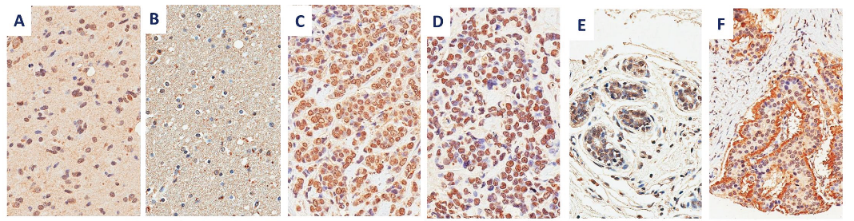
Case Study 1: Immunohistochemistry on Cancers & Normal Tissues
Target: Survivin
Goal: Detect survivin protein expression in tumor cells to establish it as a potential therapeutic target.
Survivin IHC
Tissue type | Glioblastoma | Normal brain | Invasive ductal carcinoma | Lobular breast carcinoma | Normal breast | Typical carcinoid tumor
Staining pattern | Nuclear | Negative | Nuclear | Nuclear | Negative | Apical
Published in Fenstermaker et al.(2018) Clinical Cancer Research

Slide 21
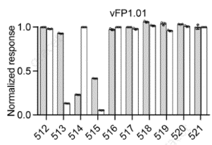
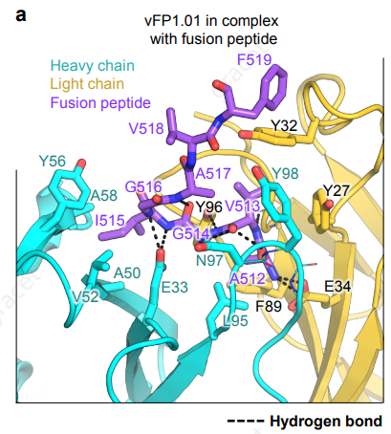
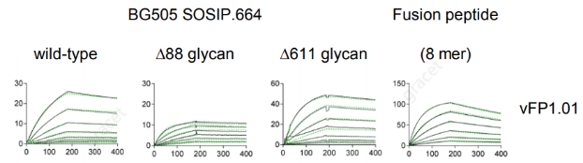
Case Study 2: Vaccine Development Assays
Goal: Develop a vaccine that can neutralize diverse strains of HIV-1.
Result: vFP1.01-FP was one of > 10 mAbs generated as part of this collaboration.
Alanine Scanning
Crystal Structure
Surface Plasmon Resonance
Published in Xu et al. (2018) Nature (GenScript collaboration with Vaccine Research Center at the NIH)

Slide 22
Rabbit Monoclonal Antibody

Slide 23
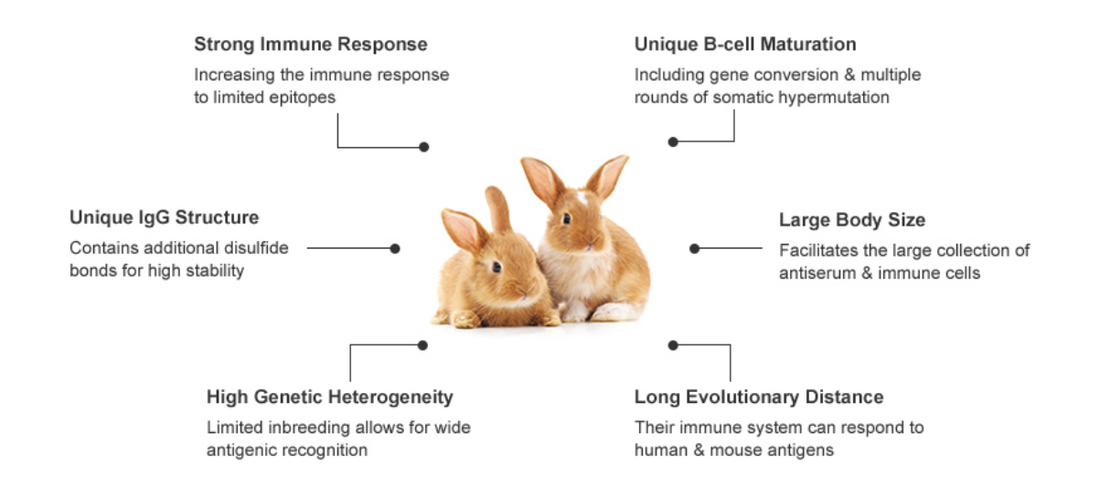
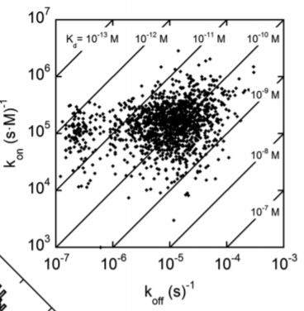
Benefits of Rabbit mAbs
Rabbits have a robust and unique immune system that enables to generate antibodies compared to rodents (up to 10 – 100x higher affinity) with
Superior specificity,
High affinity,
High diversity.
J. P. Landry et al. J Immunol Methods (2015)

Slide 24
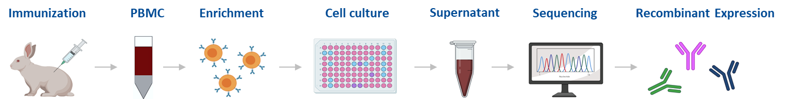
B Cell Cloning Platform for MonoRabTM Rabbit mAb Generation
Overview of MonoRab™ B Cell Cloning: Involves isolation, enrichment, and culturing of antigen-positive B cells from rabbit peripheral blood mononuclear cells (PBMCs) for screening and selection. Desired mAb clones are sequenced and recombinantly expressed.
Achieve rabbit mAbs ideal for your research applications in as fast as 11weeks!
With Phoenix MonoRabTM immunization method!

Slide 25
Custom MonoRabTM B Cell Cloning Package
Phase | Description | Timeline | Deliverables
I) Animal Immunization | 4 rabbits (express or conventional immunization) | Express: 5 - 6 weeks Conventional: 8 - 10 weeks | • Antiserum report • Small scale pAb purification (optional)
II) B Cell Cloning and Screening | 1 round of B cell cloning | 3 weeks | • Positive clones report • 1 ml B cell supernatant delivery, up to 50 clones (optional) Additional screening and increased clone number delivery options are available
III) Antibody Sequencing & Small Scale Transfection | Sequencing of 5 customer-selected clones, followed by small scale rAb expression | 3 weeks | • Sequence reports • Up to 5 rAb supernatants (2 ml), or purified rAb (0.1 mg) Additional sequencing and supernatant delivery options are available
IV) Recombinant Antibody Production | Scalable expression of selected recombinant rabbit mAbs | 3 weeks | • Sequencing report • Purified antibody
50–100
No cell Fusion
Higher Clone Numbers
Increased Antibody Diversity
11 Weeks
K_{d}: 10⁻¹⁰~10⁻¹²
Faster Timeline
High Affinity

Slide 26
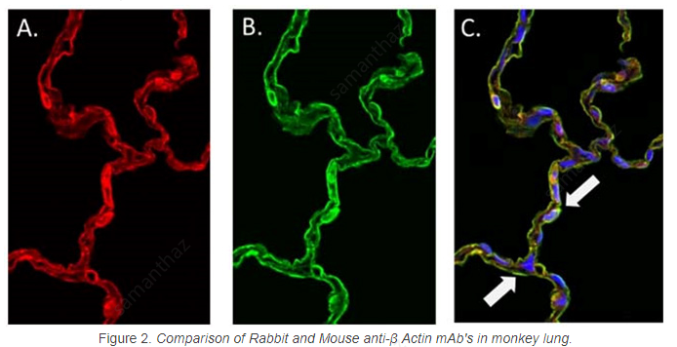
Case Study 1: Generating mAbs suited for diagnostic (IHC)
Mouse anti-b actin
Rabbit anti-b actin
Merge
Comparison of rabbit and mouse anti-beta actin in monkey lung tissue.
GenScript-generated mouse anti-beta actin mAb was visualized via anti-mouse 568 (A) and directly compared with GenScript generated rabbit anti-β actin visualized with anti-rabbit FITC (B). The resulting co-localization image (C) revealed significantly more binding of rabbit anti-beta actin than mouse, as highlighted by the white arrows, indicating that the rabbit anti-β actin mAb has a much higher affinity than its mouse generated counterpart.

Slide 27
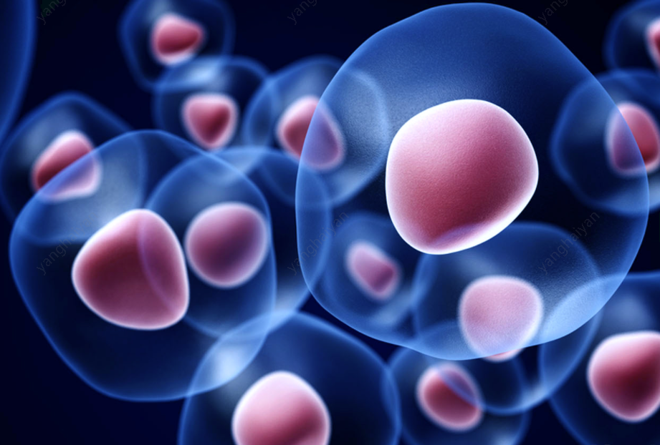

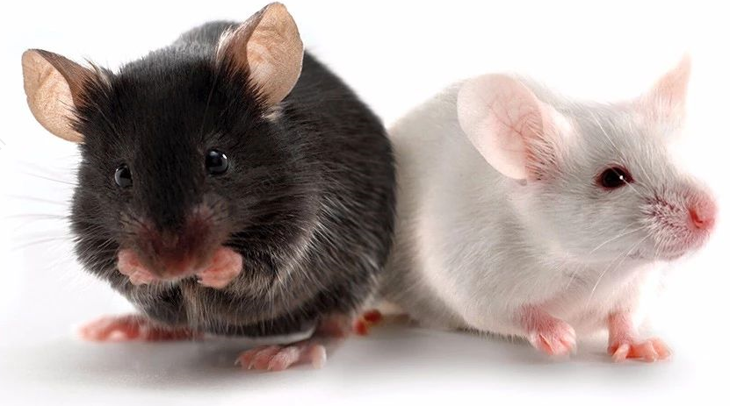
Case Study 2: Generating mAbs suited for therapeutics
Rabbit monoclonal Abs generation for 4-1BB project
Immunogen: ECD of human 4-1BB
Screening: Indirect ELISA with protein and overexpressed cell line
Validation: FACS
Protein Screening
107 ELISA positive clones
Human and Cyno 4-1BB
43 FACS positive clones
Human, Cyno and Mouse 4-1BB
9 FACS positive clones
High successful rate to obtain Abs with Cross-reactivity of Human, Cyno and Mouse.

Slide 28
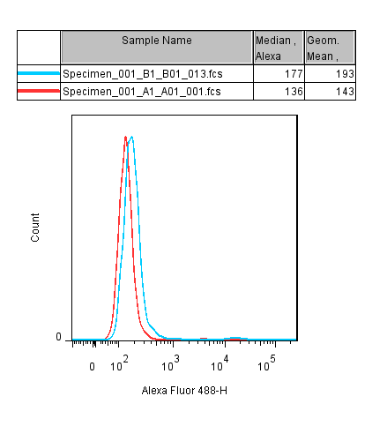
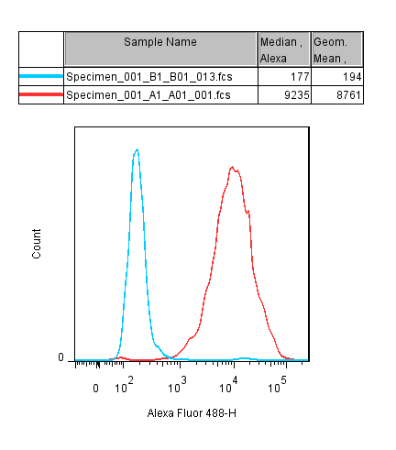
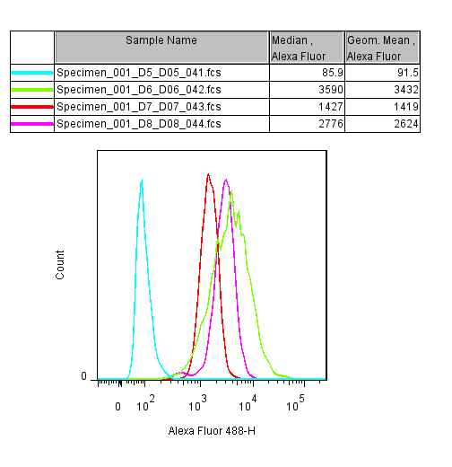
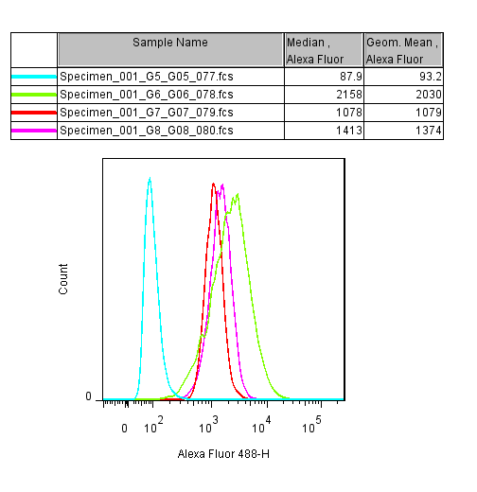
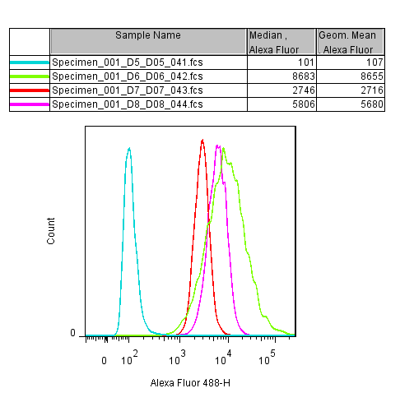
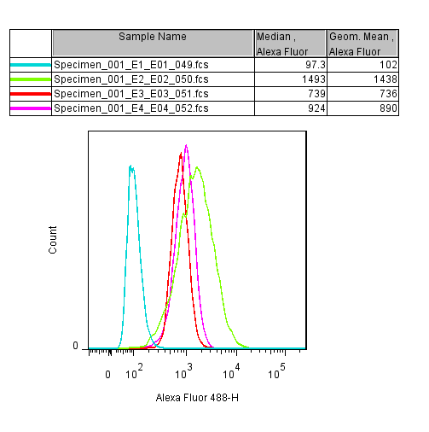
Case Study 2: Generating mAbs suited for therapeutics
Rabbit monoclonal Abs generation for 4-1BB project - FACS results
Blue: Control cell line
Red: Human 4-1BB cell line
Pre Serum：1/300
3rd Serum：1/300
Serum titer
FACS validation with B cell supernatants
16D8
46E4
127A1
140E10
Blue: CHO-K1
Green: human 4-1BB
Red: cyno 4-1BB
Purple: mouse 4-1BB
Triple positive clones

Slide 29
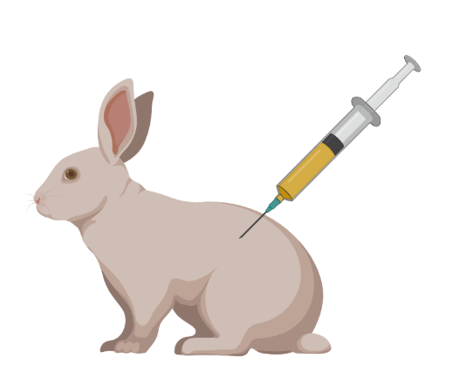
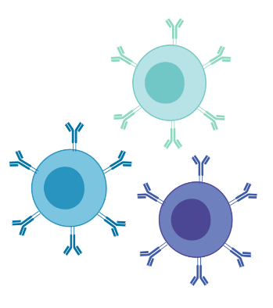
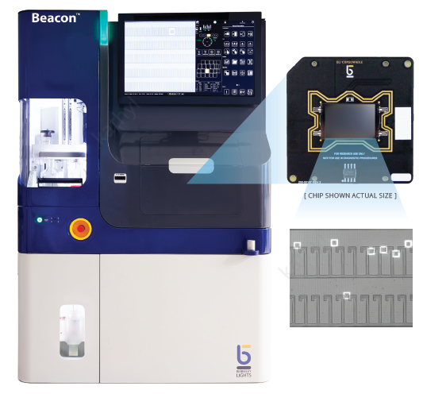
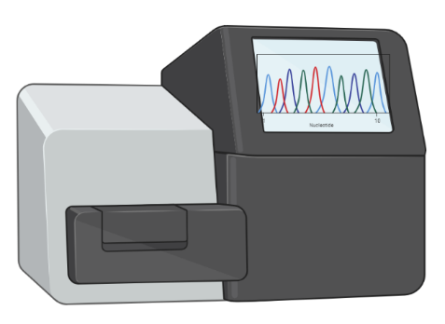
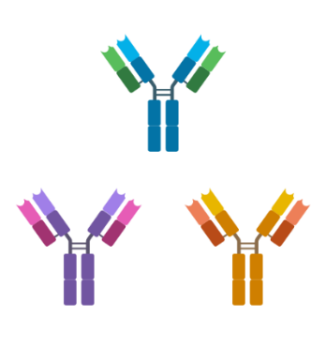
Beacon® – Single B Cell Sorting Platform for Rabbit mAb Generation
Phase I
Animal Immunization or PBMC
Phase II
ASC Enrichment
Phase III
Beacon Single Cell Screening
Phase IV
Single B Cell Sequencing
Phase V
Small-Scale rAb Expression
Milestones | Description | Time
Phase I Preparation | Animal immunization and starting material preparation | 5-9 wks
Phase II Screening and on-chip assay via Beacon | Single B cell sorting and on-chip assay to find positive clones | 1 week
Phase III Antibody Production | Variable domain sequencing and recombinant antibody expression | 4 wks

Slide 30
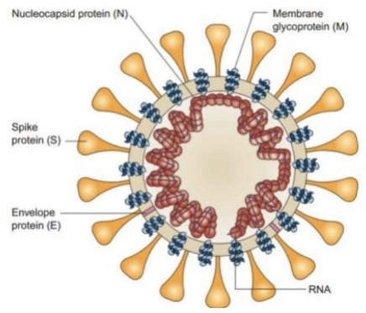
Case Study: SARS-CoV-2 Antibody Development
Antigen: SARS-Cov-2-S Protein
142 Antigen positive hits
Antigen positive screening
Timing：1h
15726 single B cells on Beacon
Timing：2h
SARS-CoV-2
Antigen + IgG+ B cells enrichment
Timing: 2 h
Express Immunization
Timing: 8 weeks
Single cell suspension
prepared from spleen
Timing: 2 h

Slide 31
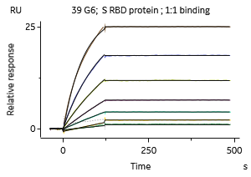
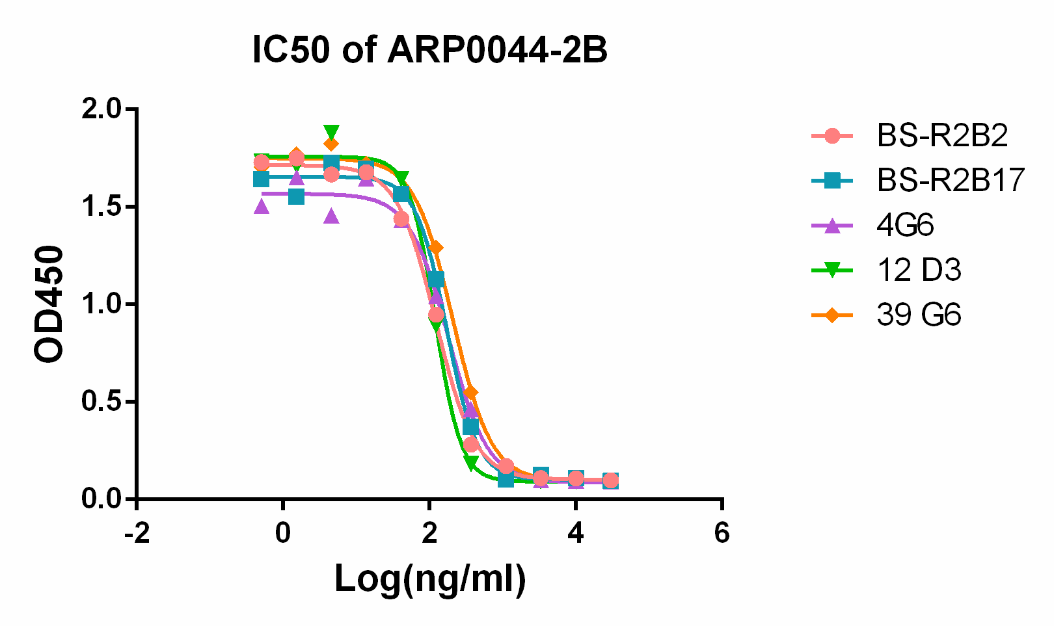
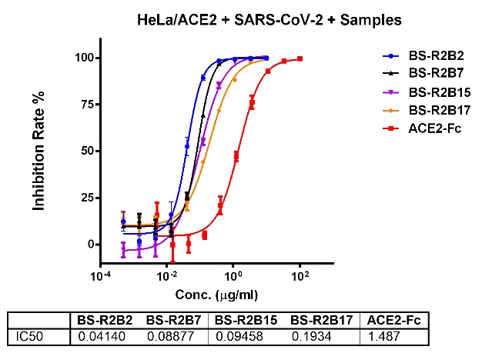
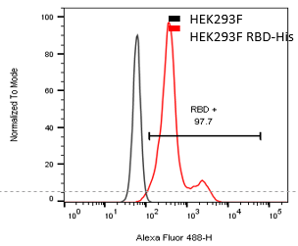
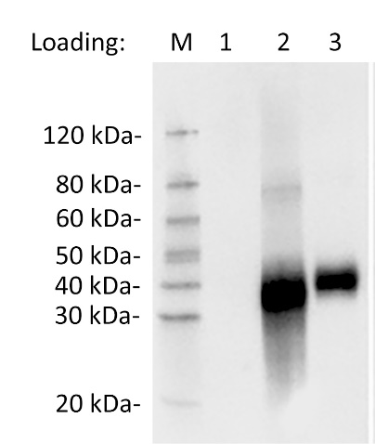
Case Study: SARS-CoV-2 Antibody Development
K_{D}(M)=3.05E-11
Epitope 1 | BS-R2B12 | BS-R2B16 | BS-R2B30
Epitope 2 | BS-R2B17 | BS-R2B27 | BS-R2B50
Epitope 3 | BS-R2B2 | 4G6 | 12D3 | 39G6
Epitope 4 | BS-R1B8
High affinity to IgG
High diversity to IgG epitopes
Good blocking effect on the ACE2 protein
Good pseudovirus neutralization
Detect overexpressing cell by FACS
WB validation of RBD

Slide 32
Antibody Sequencing & Production

Slide 33
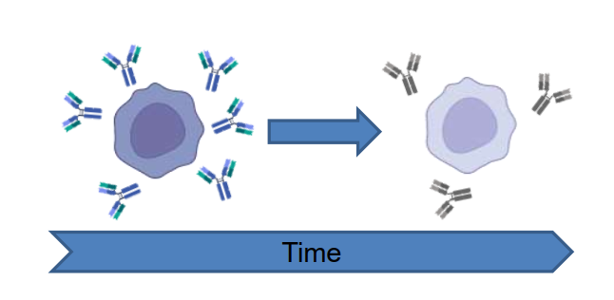
Why needs Hybridoma sequencing?
Hybridomas may become unstable over time resulting in:
Reduced viability and yield
Altered antibody properties
Sequencing helps preserve antibody sequences.
This helps in:
Patent protection
Antibody engineering projects
Ensuring stable, consistent antibody production

Slide 34
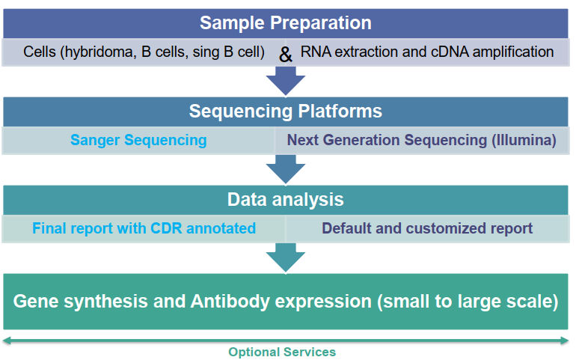
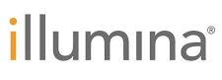
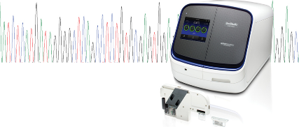
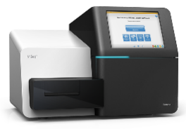

Antibody Sequencing Workflow
First-generation sequencing
Second(Next)- generation sequencing
Sanger sequencing ABI 3730 XL 600-800bp Golden standard
SBS sequencing (illumina) Miseq 300-600bp High throughput

Slide 35
Antibody Sequencing Packages
Service Packages | Description | Timeline
Standard variable domain and leader sequence sequencing (SC2188/SC2188-US) | Alignment data; Sequence raw data; Expression constructs; Sequencing construct and QC; Isotype determination | 2 wks
Standard full-length antibody sequencing (SC2189) | Alignment data; Sequence raw data; Expression constructs; Sequencing construct and QC; Isotype determination | 2 wks
High throughput Antibody Sequencing (NGS) (SC2190) | Cell processing, RNA extraction and reverse transcription NGS sequencing and data analysis | 2 wks
Sequence to recombinant Antibody (SC2179) | 1mg recombinant expression & 1-step purification | 4 wks

Slide 36
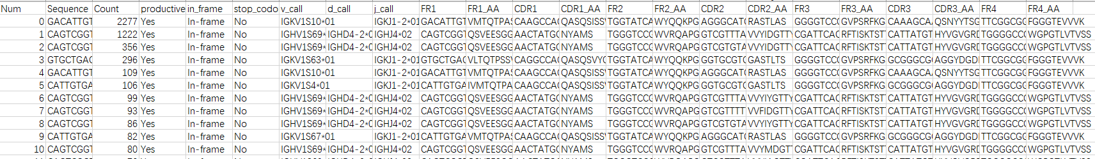
Case Study: NGS Sequencing Report
The default report will include:
DNA and Amino Acid sequences;
CDR and FR regions are defined by Kabat rules;
Count number of top 10 sequences are obtained by NGS.
Optional choices:
Phylogenetic tree analysis；
Sequence alignment of variable regions or specific CDR sequences；
Unique sequences to exclude the similarity sequences (Clients can require at least 2 or more different amino acids contained)；
CDR length analysis；
Germline analysis；
Other analyses can be achieved by our bioinformaticians.

Slide 37
IMGT, International ImMunoGeneTics information system ®
Case Study: Germline Analysis and CDR Length Analysis
Indicate Antibody Diversity
Percentage of V-gene germline
Percentage of V-gene germline
V-Gene Germline
V-Gene Germline
Indicate Antibody Candidate
Percentage of CDR3 length
Percentage of CDR3 length
V-Gene Germline
V-Gene Germline

Slide 38
Custom ELISA Kit Development

Slide 39

GenScript One-Stop Solution for Kit Development
One-stop service from RUO to GMP
Match different applications
Abundant
Production Experience
One Stop service
Clinical Grade Development
Antibody discovery:＞18 Years
Kit projects:＞70
Delivery kit quantity:＞15W
Released above FDA standards
Accuracy: Recovery 80-120%
Precision: C.V.＜10%

Slide 40
General Workflow of Kit Development
Immunogen Preparation and Immunization
Hybridoma/ B cell cloning/Beacon platform
Affinity ranking and Epitope binning
Antibody conjugation and Pairing
Kit development
Clinical Trial
Kit Transfer to production
Kit manufacturing
(GMP level)
Kit registration
Antibody Discovery
Kit development

Slide 41
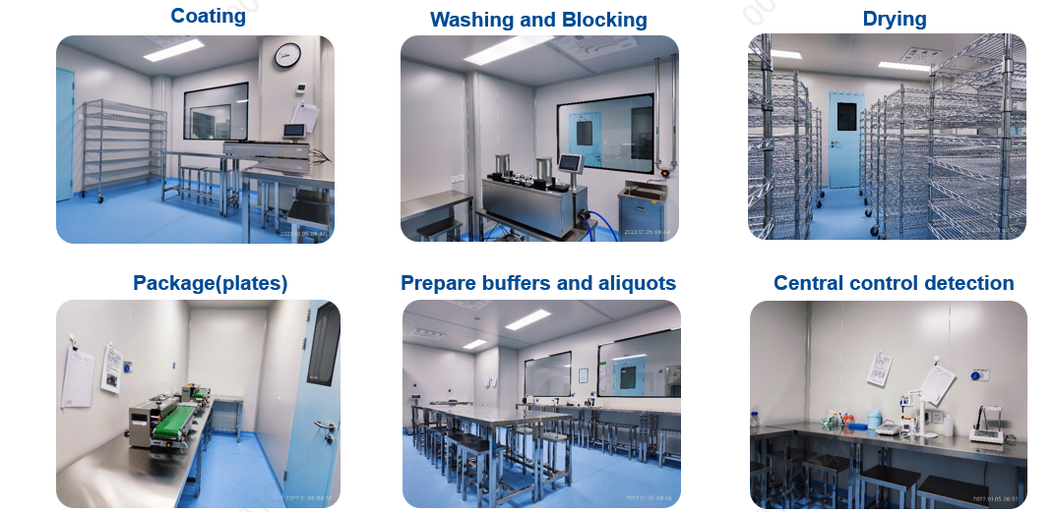
Our Facility

Slide 42
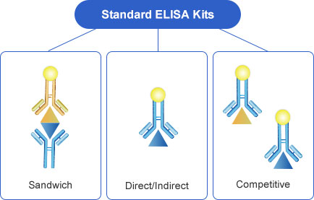
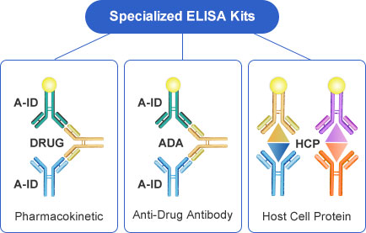
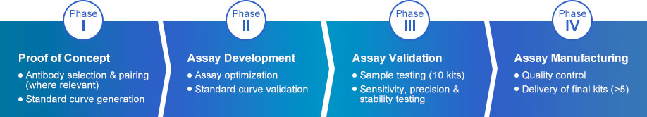
Custom ELISA Kit Services
Anti-Drug Antibody kit (TAT: 13 – 19 weeks)
Pharmacokinetic kit (TAT: 9 – 13 weeks)
Host Cell Protein kit (TAT: 10 – 15 weeks)
1-2 weeks
3-4 weeks
3-4 weeks
3-4 weeks

Slide 43
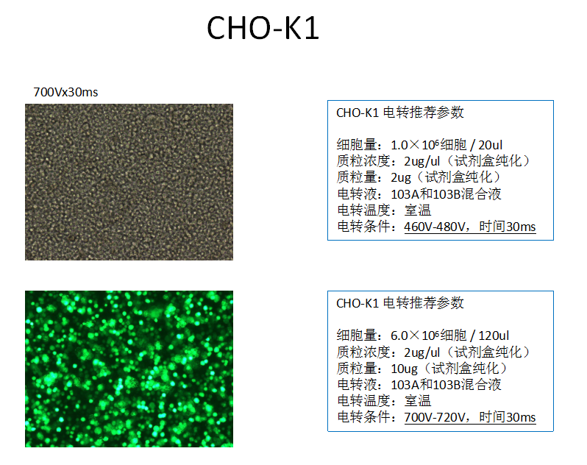
Case Study 1: HCP ELISA Kit - CHO
All indicators of the HCP kit developed by GenScript meet or exceed FDA requirements
Parameters | Data | FDA requirement
Linear range | 1-100 ng/mL
Sensitivity | 0.608 ng/mL
Precision – Intra assay Variation | ≤5% | ≤20%
Precision - Inter-assay variance | ≤10% | ≤20%
Accuracy-Recovery | 85-115% | 70-130%
Specificity | Drug
Matrix | Injection salt solution
Application: CHO detection
Method: Sandwich ELISA

Slide 44
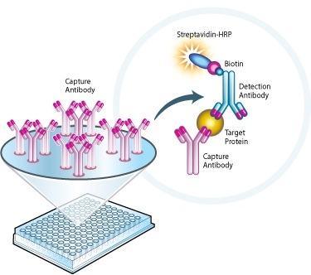
Case Study 2: Anti-PK ELISA Kit
All indicators of the PK kit developed by GenScript meet or exceed FDA requirements
Application: PK
Method: Sandwich ELISA
Parameter | GenScript
Linear range | 0.5 ng/ml~24ng/ml
ULOQ LLOQ | 24 ng/ml 0.5 ng/ml
Selectivity | 80%
Precision | Intra assay CV<10% Inter assay CV<10%
Recovery/ Interference Studies | 80-120%
Specificity/Cross-Reactivity | Not Done
Matrix | Human Serum

Slide 45
Why Choose GenScript’s Reagent Antibody Services?
Fully Experienced
Award-Winning Services
01
04
18 years of experience and 150,000+ antibodies successfully delivered to date
2018 CiteAb winner for Most Popular Custom Antibody Supplier
Proprietary Technologies
Ownership & IP Protected
02
05
Maximize your success at achieving high-quality antibodies
Customer has complete ownership & IP over all antibodies generated
Specialized Services
03
06
Ph.D.-Level Support
Antibody production, labeling, ELISA kit generation, and more
Dedicated Ph.D.-level project managers to provide 24-hour technical support, Monday to Friday

Slide 46
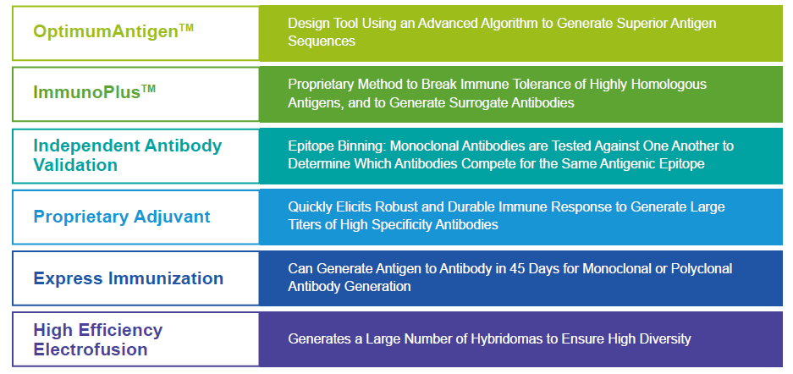
Our Antibody Technologies
Our proprietary antibody technologies help maximize your success at generating a high-specificity, high-affinity antibody that works in your research application.

Slide 47
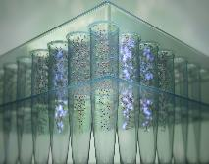
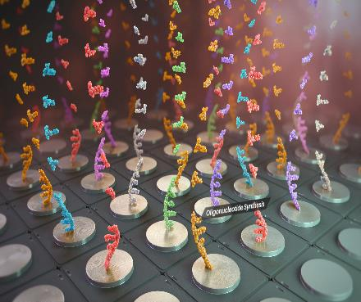



By Partnering with GenScript, YOU Level Up!
# 1 provider of GENE synthesis services in the world
5,200+ employees comprised of 40% M.S. & Ph.D. scientists
Comprehensive service to scientists in 100 countries
30,000+ citations in peer-reviewed journal articles
#WeMakeDNAandMORE
YOU

Slide 48


Thank you
Contact Us
877-436-7274;732-885-9188
antibody@genscript.com
860 Centennial Ave. Piscataway NJ 08854

